Slide 1

Dome Concessions Shift & Pay Portal
IST 659 – Database Management systems
Hitesh Thadhani
Dec 2, 2019

Slide 2
PROJECT GOALS
Major functions of database systems are :
What data to collect
Employee details are collected
Shift details which are picked up by employees
Game details for which employees have picked up the shifts
Track Records have feedback and disciplinary points if any for the employees
Manager details who approve the Dropped shifts by employees
To save manual time and effort for scheduling for each game
Automating the shift schedule processing including Drop and Pick Shifts.
Payroll for all the employees and maintain track records to show efficiency of the employees

Slide 3
PROJECT GOALS
Who can Input the data
Supervisor
Manager
Administrative Team
Who can query the data
Supervisor
Manager
Employees

Slide 4
PROJECT GOALS
What are the major data questions
Which students pick shifts for the game and which do not? Active Students can be found out.
How Feedback can be used to track students work and their efficiency?
What is the average payment made for a particular game to employees?
What are the reasons given by employees to drop a shift?
What is the annual growth in terms of customers per game?

Slide 5

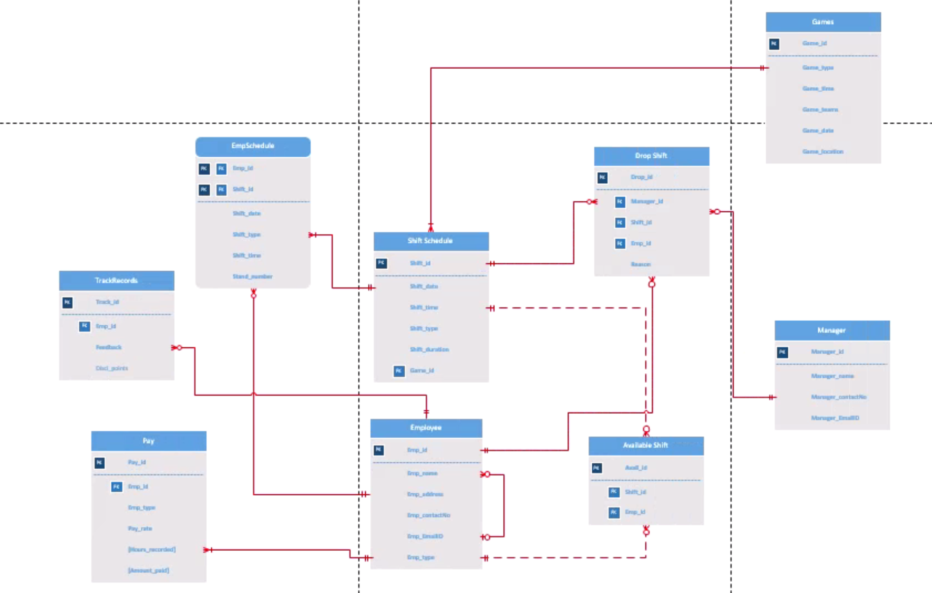

ERD - Visio

Slide 6
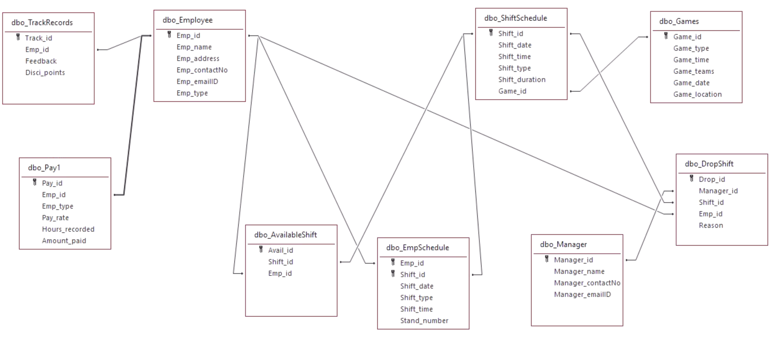
ERD – MS Access

Slide 7
Forms
Total Number of Tables : 9
Total Number of Forms : 13
Number of Forms that you created so far : 13
Login Form (Y) (user logs in to the system)
Employee Details (Y)(allows you to add and view Employee Details)
ShiftSchedule(Y) (allows you to add and view Shift details for all the games scheduled)
EmpSchedule (Y)(allows you to view Employee Schedule for each and every employee)
Manager Details(Y)(allows you to add and view Manager details)
Payroll(Y)(allows you to add record for Employees and their hours worked with the Amount to be paid)
Track Records(Y) (allows you to add Track Records for all the employees)
Game Schedule(Y) (allows you to add and view Games details)
DropShift(Y) (allows you to add and view Dropped Shifts details)
AvailableShift (Y)(allows you to retrieve about the Available shifts which can be picked up by the employees)
Reports_Page(Y)(A form which has 3 buttons for all the 3 reports to be viewed)
Navigation_Form(Y)(A form created to display menu for Successful Admin Login)
Read_Only_Form(Y)(A form created to be displayed to the Guest User on Login Page Guest Button click)

Slide 8
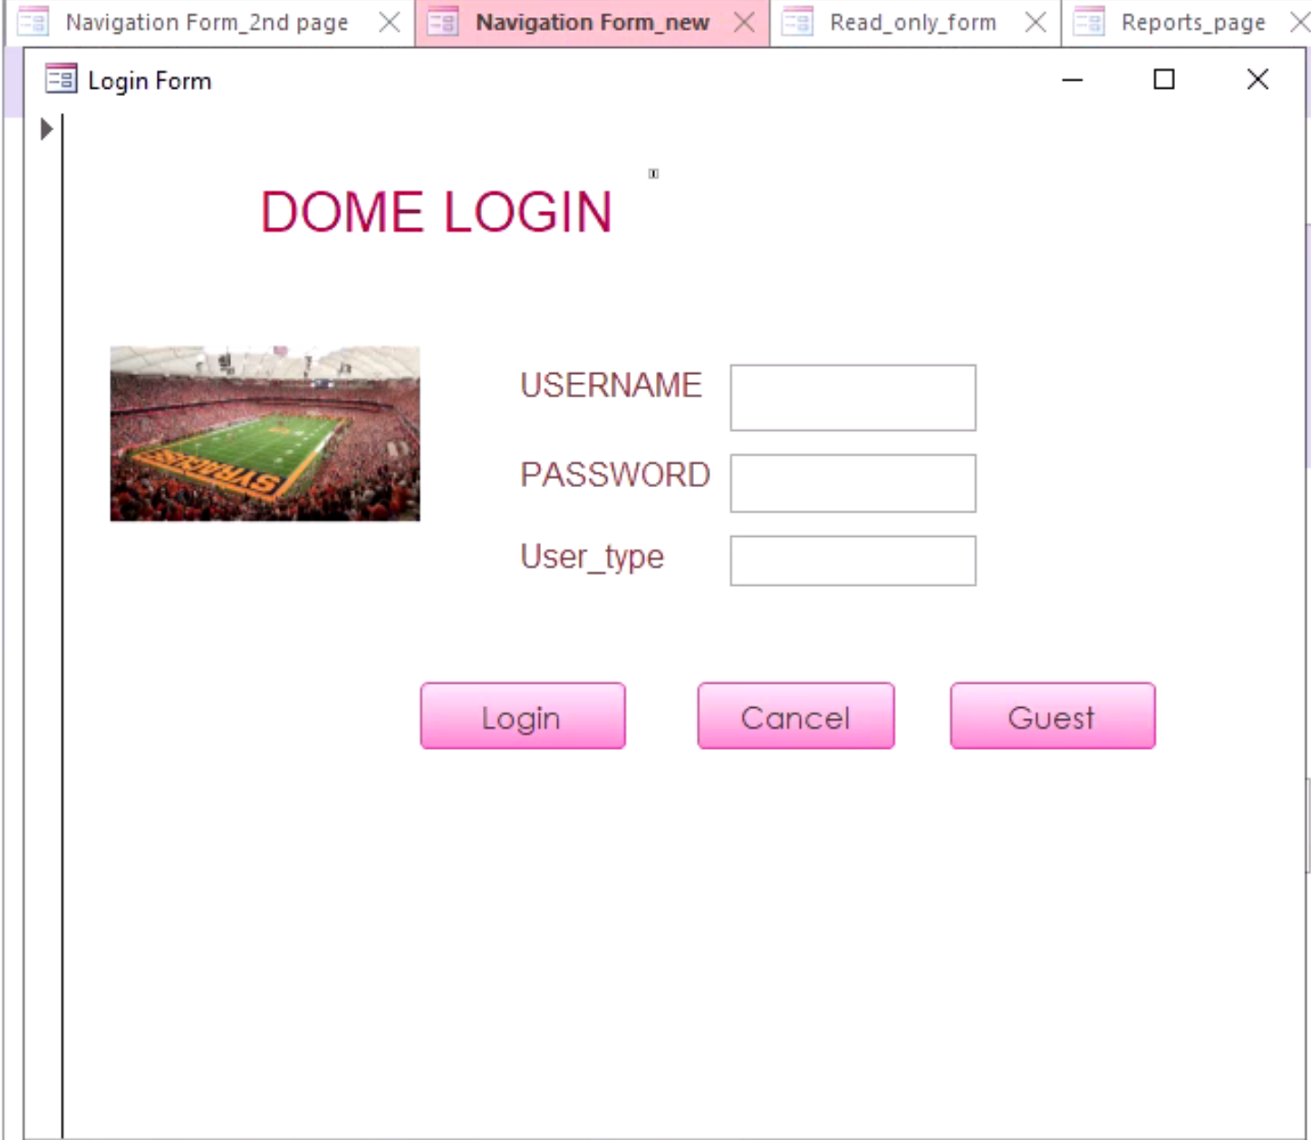
FORMS Login Form
The Login Form created has 2 main buttons Login and Guest.
For Login there are 2 different users Admin and Normal Users.
For Admin, the Login Form after successful login takes the admin to a separate page as compared to the normal users who will be re-directed to a different page.
The Guest Button is a Read Only Sub form created in Access.

Slide 9
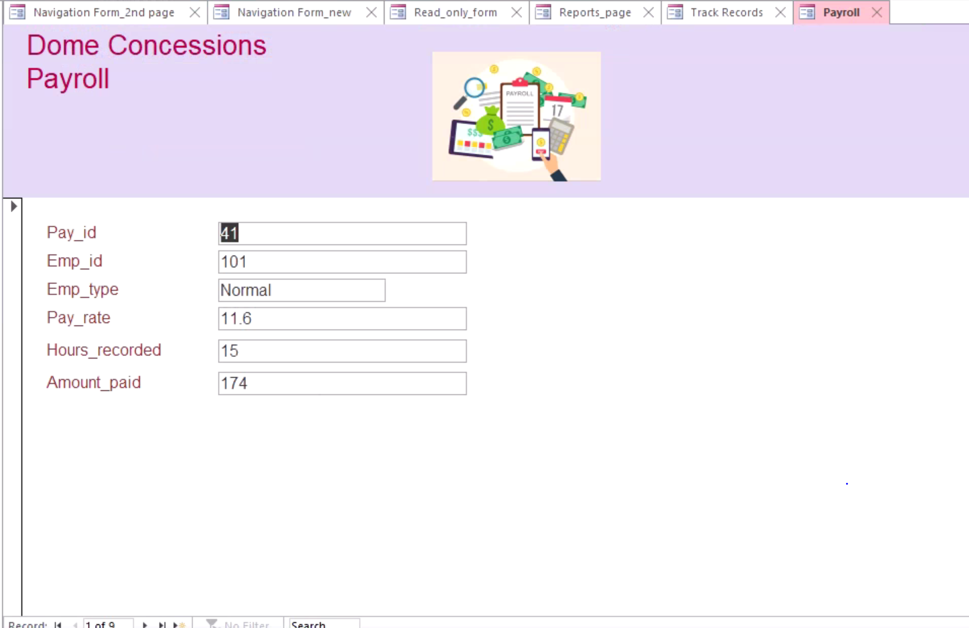
FORMS Payroll Form

Slide 10
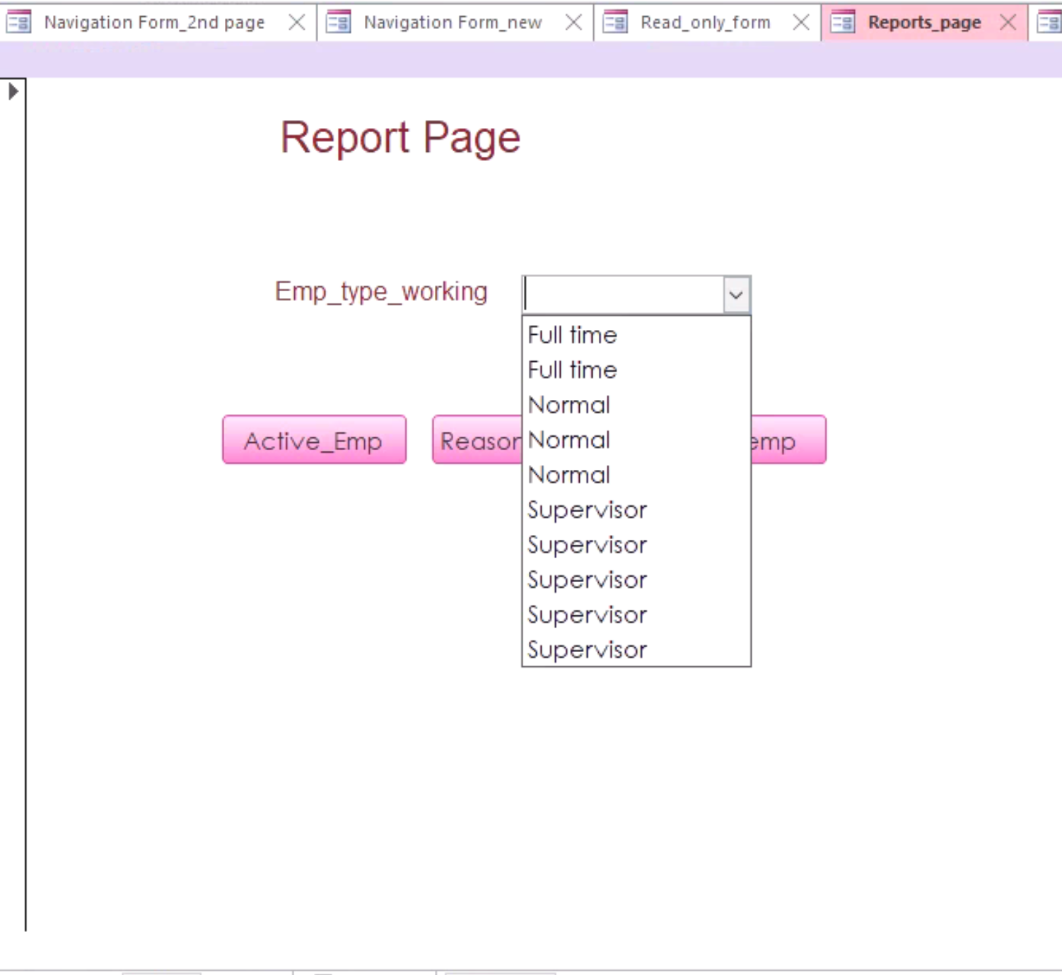
Reports Page Form
There are 3 buttons on this reports_page form.
There is a combo box created for the type of the employee working in Dome.
The Buttons take you to the desired report page when clicked on it. 3 buttons have 3 different reports linked.

Slide 11
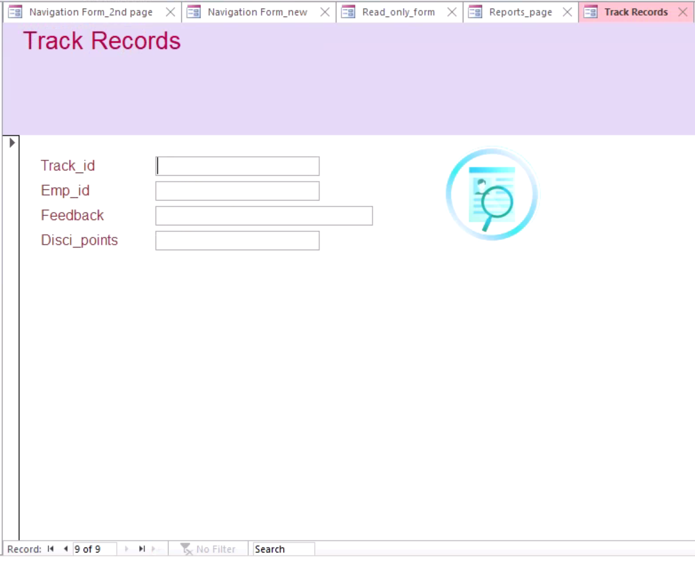
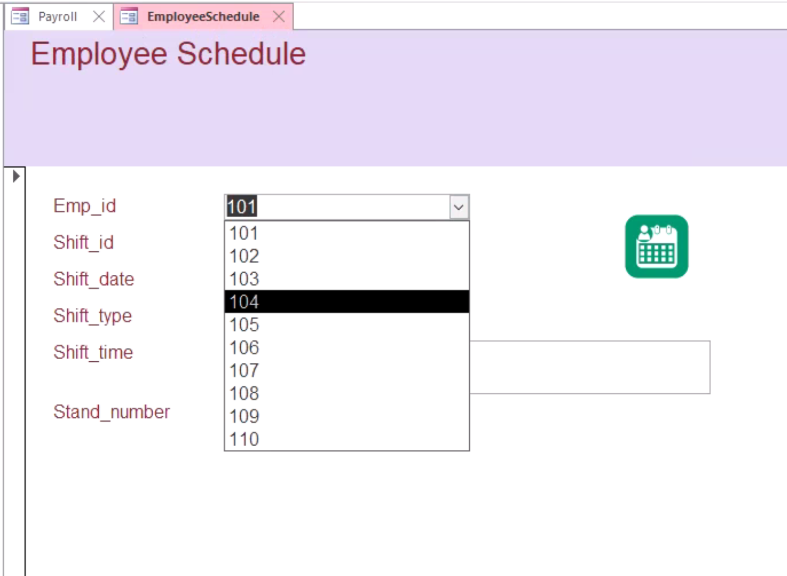
Track Records Form & Combo Box in Employee Schedule Form
New Track Records can be added on the fly in this form and this will be reflected in the table in the SQL Server.
The Employee Schedule Table has Emp_id as Foreign Key from Employee Table where it is Primary Key and so here created Combo Box on this field.

Slide 12
Major Data Questions - Reports
Which students pick shifts for the game and which do not? Active Students can be found out.(Y)
How Feedback can be used to track students work and their efficiency?(Y)
What is the average payment made for a particular game to employees?(N)
What are the reasons given by employees to drop a shift?(Y)
What is the annual growth in terms of customers per game?(N)

Slide 13
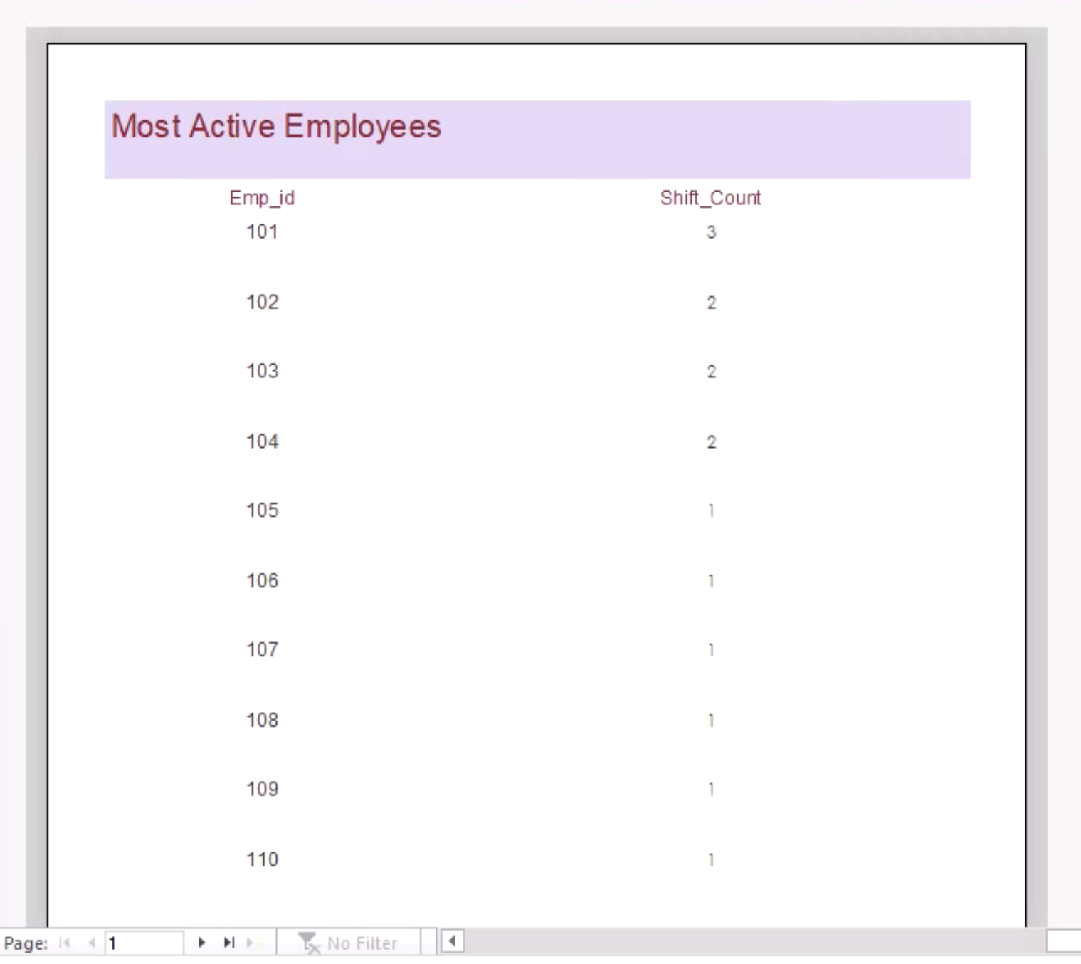
Report 1 The employees who are the most active

Slide 14
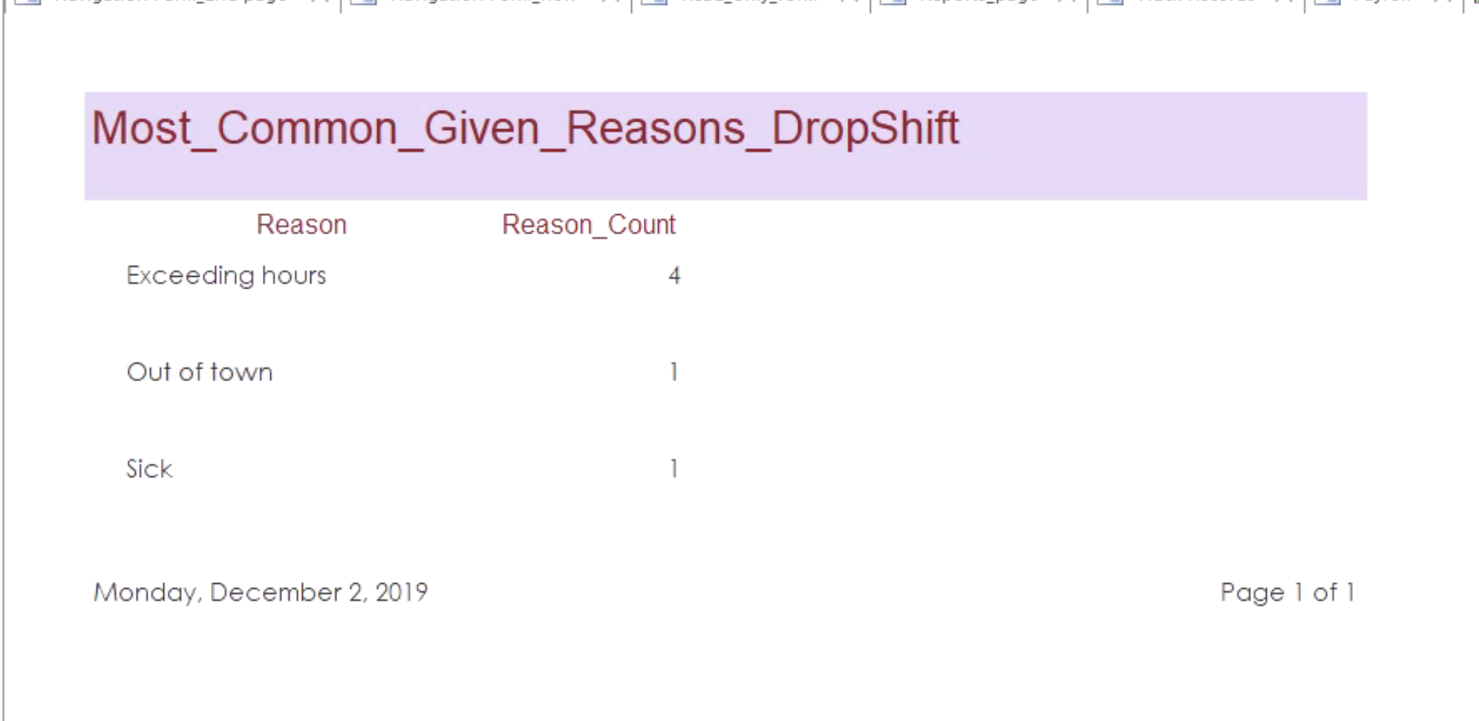
Report 2 Most Common Reasons Given while Dropping the Shift

Slide 15
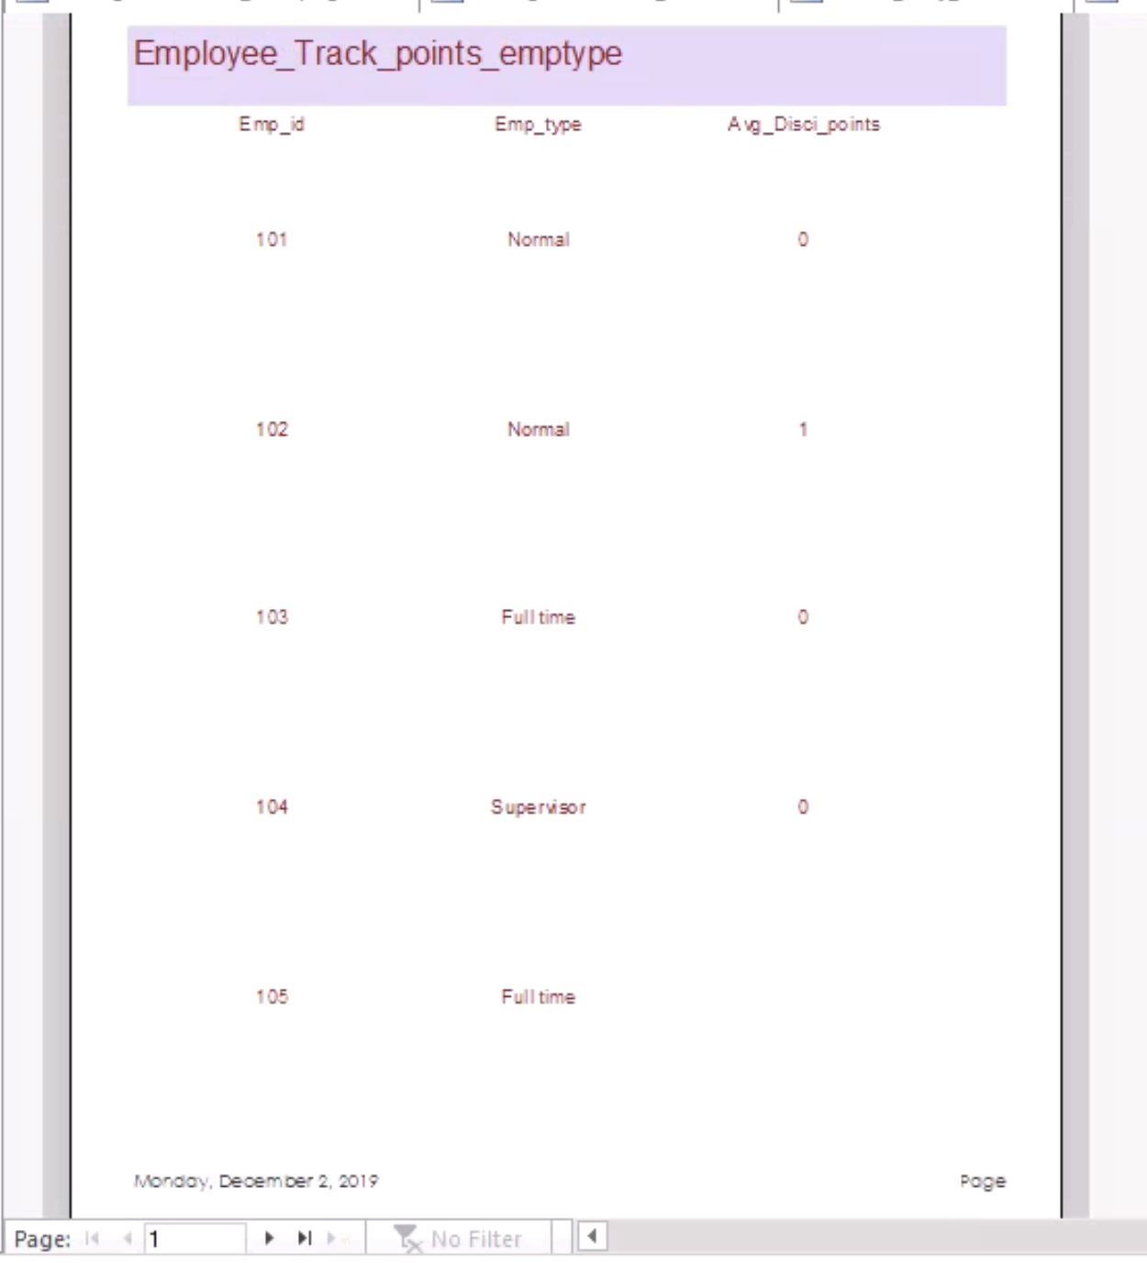
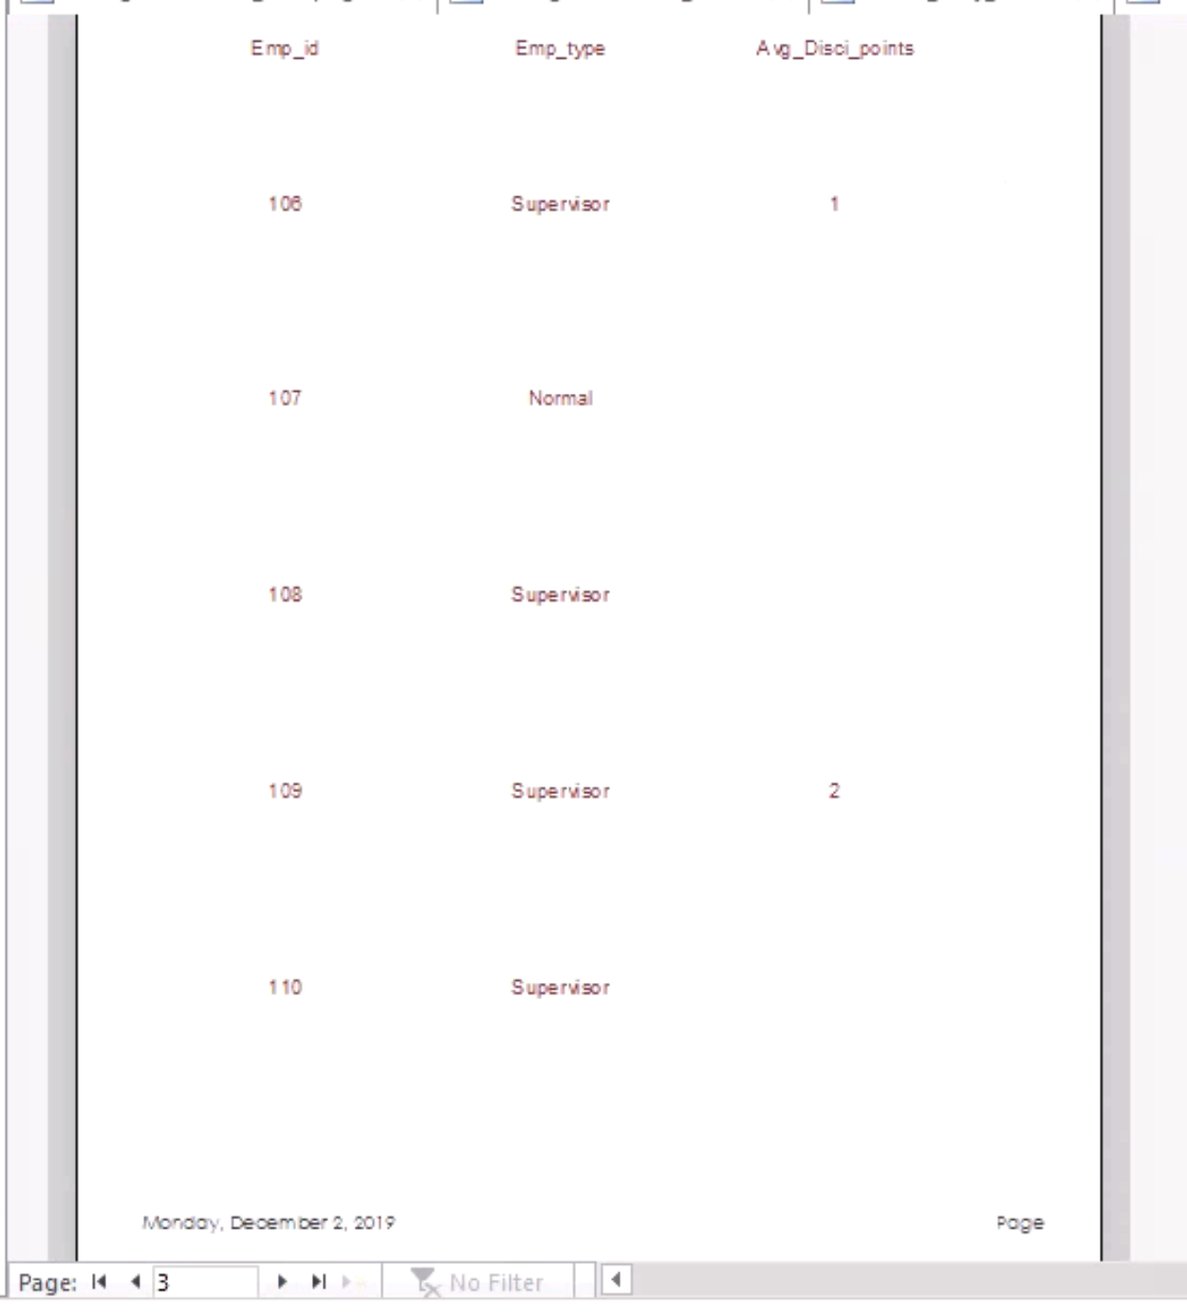
Report 3 Average Disciplinary Points for all the Employees

Slide 16
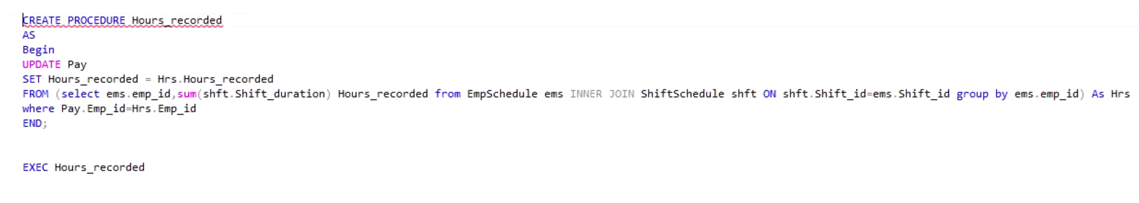
Procedure to Update Hours Recorded by the employees

Slide 17
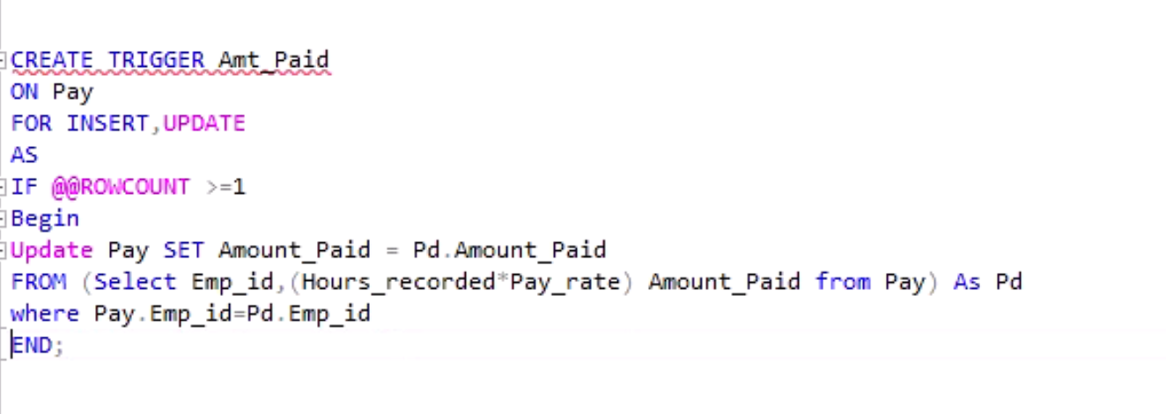
Trigger to Update the Amount Paid to the employees

Slide 18
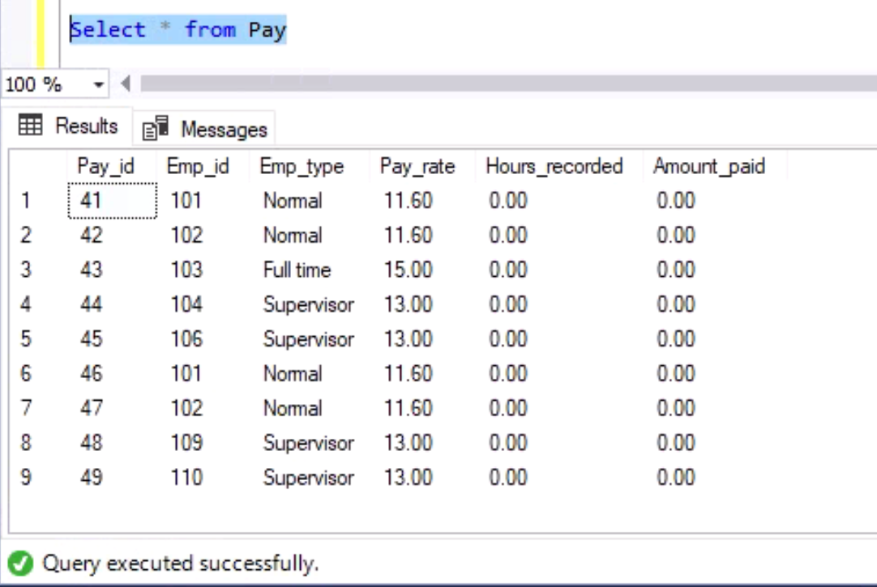
Trigger is yet to run before running output

Slide 19
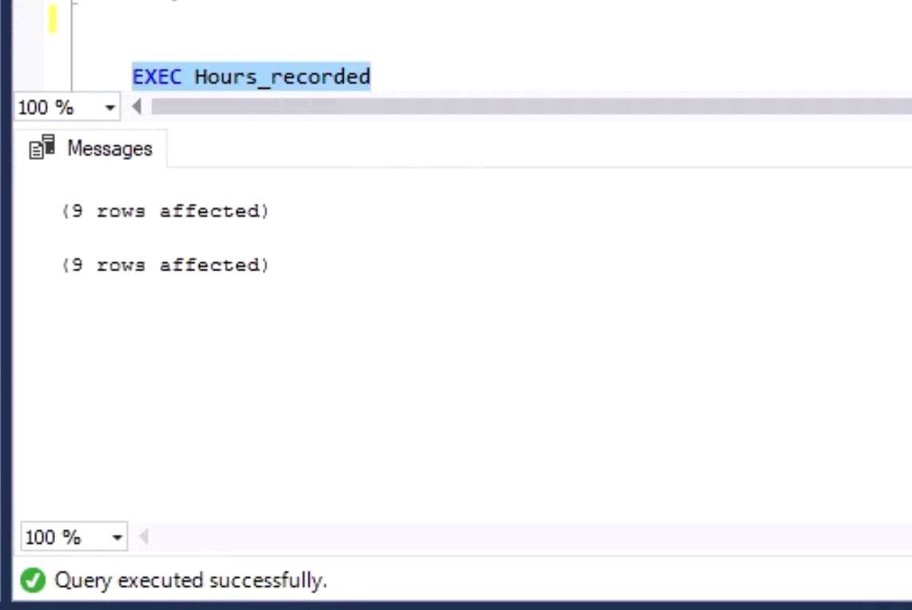

Executed the Procedure on the Pay Table causing the Trigger to come into effect
Procedure Hours_recorded is executed causing the hours to get updated and the trigger runs at the same time to update the Payable Amount in the Amount_Paid Column based on Hours and Pay rate for that particular employee. 9 rows for Hours_recorded are updated and at the same time 9 rows for Amount_Paid are also updated which is shown in the output

Slide 20
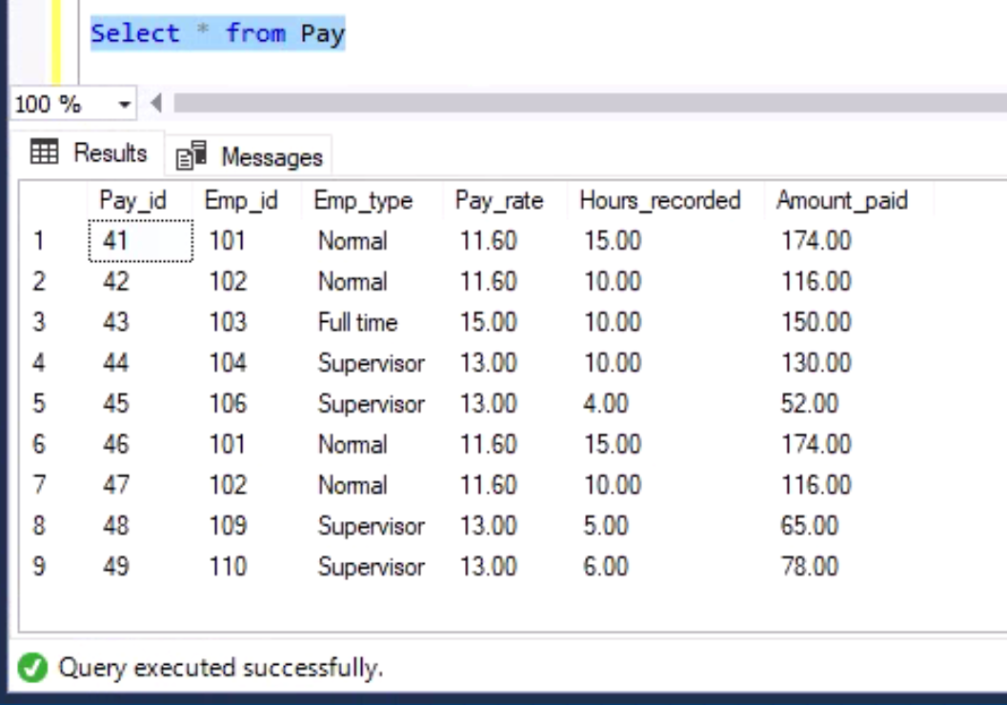
Output after changes are made to the Pay table

